Slide 1
Lexical Analysis
CSE 340 – Principles of Programming Languages
Summer 2016
Ayan Banerjee
Arizona State University
Adopted from slides by Adam Doupe

Slide 2
Language Syntax
Programming Language must have a clearly specified syntax
Programmers can learn the syntax and know what is allowed and what is not allowed
Compiler writers can understand programs and enforce the syntax

Slide 3
Language Syntax
Input is a series of bytes
How to get from a string of characters to program execution?
We must first assemble the string of characters into something that a program can understand
Output is a series of tokens

Slide 4
Language Syntax
In English, we have an alphabet
a…z, ,, ., !, ?, …
However, we also have a higher abstraction than letter in the alphabet
Words
Defined in a dictionary
Categorized into
Nouns
Verbs
Adverbs
Articles
Sentences
Paragraphs

Slide 5
Language Syntax
In a programming language, we also have an alphabet (the symbols that are important in the specific language)
a, z, ,, ., !, ?, <, >, ;, }, {, (, ), …
Just as in English, we create abstractions of the low-level alphabet
Tokens
==
<=
while
if
Tokens are precisely specified using patterns

Slide 6
Strings
Alphabet symbols together make a string
We define a string over an alphabet 𝛴 as a finite sequence of symbols from 𝛴
𝜺 is the empty string, an empty sequence of symbols
Concatenating 𝜺 with a string s gives s
𝜺s = s 𝜺 = s
In our examples, strings will be stylized differently, either
"in between double quotes"
italic and dark blue

Slide 7
Languages
𝛴 represents the set of all symbols in an alphabet
We define 𝛴* as the set of all strings over 𝛴
𝛴* contains all the strings that can be created by combining the alphabet symbols into a string
A language L over alphabet 𝛴 is a set of strings over 𝛴
A language L is a subset of 𝛴*
Is 𝛴 infinite?
Is 𝛴* infinite?
Is L infinite?

Slide 8
Regular Expressions
Tokens are typically specified using regular expressions
Regular expressions are
Compact
Expressive
Precise
Widely used
Easy to generate an efficient program to match a regular expression

Slide 9
Regular Expressions
We must first define the syntax of regular expressions
A regular expression is either
∅
𝜺
a, where a is an element of the alphabet
R₁ | R₂, where R₁ and R₂ are regular expressions
R₁ . R₂, where R₁ and R₂ are regular expressions
(R), where R is a regular expression
R*, where R is a regular expression

Slide 10
Regular Expressions
A regular expression defines a language (the set of all strings that the regular expression describes)
The language L(R) of regular expression R is given by:
L(∅) = ∅
L(𝜺) = {𝜺}
L(a) = {a}
L(R₁ | R₂) = L(R₁) ∪ L(R₂)
L(R₁ . R₂) = L(R₁) . L(R₂)

Slide 11
L(R₁ | R₂) = L(R₁) ∪ L(R₂)
Examples:
L(a | b) = L(a) ∪ L(b) = {a} ∪ {b} = {a, b}
L(a | b | c) = L(a | b) ∪ L(c) = {a, b} ∪ {c} = {a, b, c}
L(a | 𝜺) = L(a) ∪ L(𝜺) = {a} ∪ {𝜺} = {a, 𝜺}
L(𝜺 | 𝜺) = {𝜺}
{𝜺} ?= {}

Slide 12

L(R₁ | R₂) = L(R₁) ∪ L(R₂)
Examples:
L(a | b) = L(a) ∪ L(b) = {a} ∪ {b} = {a, b}
L(a | b | c) = L(a | b) ∪ L(c) = {a, b} ∪ {c} = {a, b, c}
L(a | 𝜺) = L(a) ∪ L(𝜺) = {a} ∪ {𝜺} = {a, 𝜺}
L(𝜺 | 𝜺) = {𝜺}
{𝜺} $≠$ {}

Slide 13
L(R₁ . R₂) = L(R₁) . L(R₂)
Definition
For two sets A and B of strings:
A . B = {xy : x ∈ A and y ∈ B}
Examples:
A = {aa, b }, B = {a, b}
A . B = {aaa, aab, ba, bb}
ab ?∈A . B
A = {aa, b, 𝜺}, B = {a, b}
A . B = {aaa, aab, ba, bb, a, b}

Slide 14
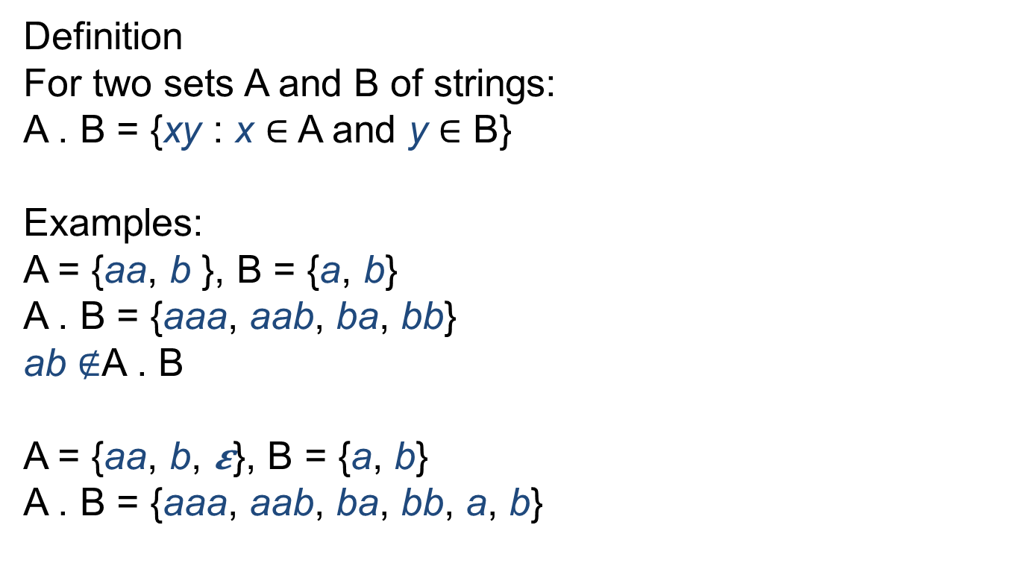
L(R₁ . R₂) = L(R₁) . L(R₂)
Definition
For two sets A and B of strings:
A . B = {xy : x ∈ A and y ∈ B}
Examples:
A = {aa, b }, B = {a, b}
A . B = {aaa, aab, ba, bb}
ab $∉$A . B
A = {aa, b, 𝜺}, B = {a, b}
A . B = {aaa, aab, ba, bb, a, b}

Slide 15
Operator Precedence
L( a | b . c )
What does this mean?
(a | b) . c or a | (b . c)
Just like in math or a programming language, we must define the operator precedence (* higher precedence than +)
a + b * c
(a + b) * c or a + (b * c)?
. has higher precedence than |
L( a | b . c) =
L(a) ∪ L(b . c) = {a} ∪ {bc} = {a, bc}

Slide 16
Regular Expressions
L( (R) ) = L(R)
L( (a | b) . c ) =
L (a | b) . L (c) =
{a, b} . {c} =
{ac, bc}

Slide 17
Kleene Star
L(R*) = ?
L (R*) = {𝜺} ∪L(R) ∪ L(R) . L(R) ∪L(R) . L(R) . L(R) ∪ L(R) . L( R) . L(R) . L(R) …
Definition
L⁰(R) = {𝜺}
L^{i}(R) = L^{i-1}(R) . L(R)
L(R*) = ∪_{i≥0} L^{i}(R)

Slide 18
L(R*) = ∪_{i≥0} L^{i}(R)
Examples
L(a | b*) = {a, 𝜺, b, bb, bbb, bbbb, …}
L((a | b)*) = {𝜺} ∪ {a, b} ∪ {aa, ab, ba, bb} ∪ {aaa, aab, aba, abb, baa, bab, bba, bbb} ∪…

Slide 19
L(R*) = ∪_{i≥0} L^{i}(R)
Examples
L(a | b*) = {a, 𝜺, b, bb, bbb, bbbb, …}
L((a | b)*) = {𝜺} ∪ {a, b} ∪ {aa, ab, ba, bb} ∪ {aaa, aab, aba, abb, baa, bab, bba, bbb} ∪…

Slide 20
Tokens
letter = a | b | c | d | e | … | A | B | C | D | E…
digit = 0 | 1 | 2 | 3 | 4 | 5 | 6 | 7 | 8 | 9
ID = letter(letter | digit | _ )*
a891_jksdbed
12ajkdfjb
Note that we've left out the . regular expression operator. It is implied when two regular expressions are next to each other, similar to x*y=xy in math.

Slide 21
Tokens
How to define a number?
NUM = digit*
132
𝜺
NUM = digit(digit)*
132
0
00000000000
pdigit = 1 | 2 | 3 | 4 | 5 | 6 | 7 | 8 | 9
NUM = pdigit(digit)*
132
0
00000000000

Slide 22
Tokens
NUM = pdigit . (digit)* | 0
123
0
00000000
1901adb

Slide 23
Tokens
How to define a decimal number?
DECIMAL = NUM . \. . NUM
1.5
2.10
1.01
DECIMAL = NUM . \. . digit*
1.5
2.10
1.01
1.
DECIMAL = NUM . \. . digit . digit*
1.5
2.10
1.01
1.
0.00
Note that here we mean a regular expression that matches the one-character string dot . However, to differentiate between the regular expression concatenation operator . and the character ., we escape the . with a \ (similar to strings where \n represents the newline character in a string). This means that we also need to escape \ with a \ so that the regular expression \\ matches the string containing the single character \

Slide 24

Lexical Analysis
The job of the lexer is to turn a series of bytes (composed from the alphabet) into a sequence of tokens
The API that we will discuss in this class will refer to the lexer as having a function called getToken(), which returns the next token from the input steam each time it is called
Tokens are specified using regular expressions
Bytes
Tokens
NUM, ID, NUM, OPERATOR, ID, DECIMAL, …
Lexer
Source

Slide 25
Lexical Analysis
Given these tokens:
ID = letter . (letter | digit | _ )*
DOT = \.
NUM = pdigit . (digit)* | 0
DECIMAL = NUM . DOT . digit . digit*
What token does getToken() return on this string:
1.1abc1.2
NUM?
DECIMAL?
ID?

Slide 26
Longest Matching Prefix Rule
Starting from the next input symbol, find the longest string that matches a token
Break ties by giving preference to token listed first in the list

Slide 27
String | Matching | Potential | Longest Match
1.1abc1.2 |  | All
1.1abc1.2 | NUM | DECIMAL, NUM | NUM, 1
1.1abc1.2 |  | DECIMAL | NUM, 1
1.1abc1.2 | DECIMAL | DECIMAL | DECIMAL, 3
1.1abc1.2
1.1abc1.2 |  | All
abc1.2 | ID | ID | ID, 1
abc1.2 | ID | ID | ID, 2
abc1.2 | ID | ID | ID, 3
abc1.2 | ID | ID | ID, 4
abc1.2 |  |  | ID, 4
abc1.2 |  | All
.2 | DOT |  | DOT, 1
.2 |  |  | DOT, 1
.2 |  | All
2 | NUM | NUM | NUM, 1
2 |  |  | NUM, 1
^
^
^
^
^
^
^
^
^
^
^
^
^
^
^
^
^

Slide 28
String | Matching | Potential | Longest Match
1.1abc1.2 |  | All
1.1abc1.2 | NUM | DECIMAL, NUM | NUM, 1
1.1abc1.2 |  | DECIMAL | NUM, 1
1.1abc1.2 | DECIMAL | DECIMAL | DECIMAL, 3
1.1abc1.2
1.1abc1.2 |  | All
abc1.2 | ID | ID | ID, 1
abc1.2 | ID | ID | ID, 2
abc1.2 | ID | ID | ID, 3
abc1.2 | ID | ID | ID, 4
abc1.2 |  |  | ID, 4
abc1.2 |  | All
.2 | DOT |  | DOT, 1
.2 |  |  | DOT, 1
.2 |  | All
2 | NUM | NUM | NUM, 1
2 |  |  | NUM, 1
^
^
^
^
^
^
^
^
^
^
^
^
^
^
^
^
^

Slide 29
Mariner 1

Slide 30
Lexical Analysis
In some programming languages, whitespace is not significant at all
In most programming language, whitespace is not always significant
( 5 + 10 ) vs. (5+10)
In Fortran, whitespace is ignored
DO 15 I = 1,100
DO 15 I = 1.100
DO15I = 1.100
Variable assignment instead of a loop!

